Slide 1


Slide 2
Chapter 2
Database System Concepts and Architecture

Slide 3
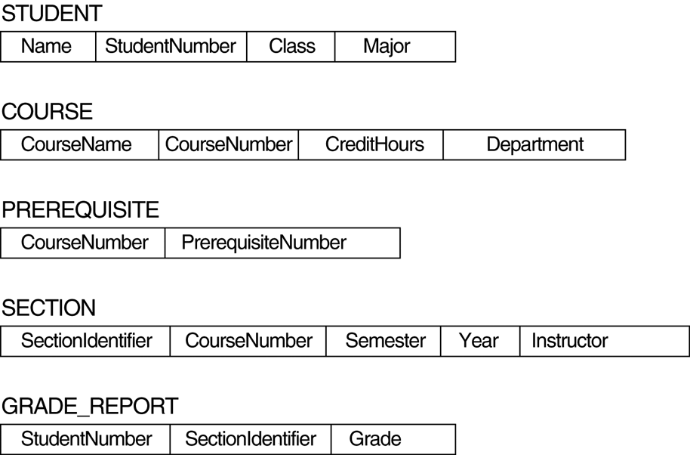
FIGURE 2.1
Schema diagram for the database in Figure 1.2.

Slide 4
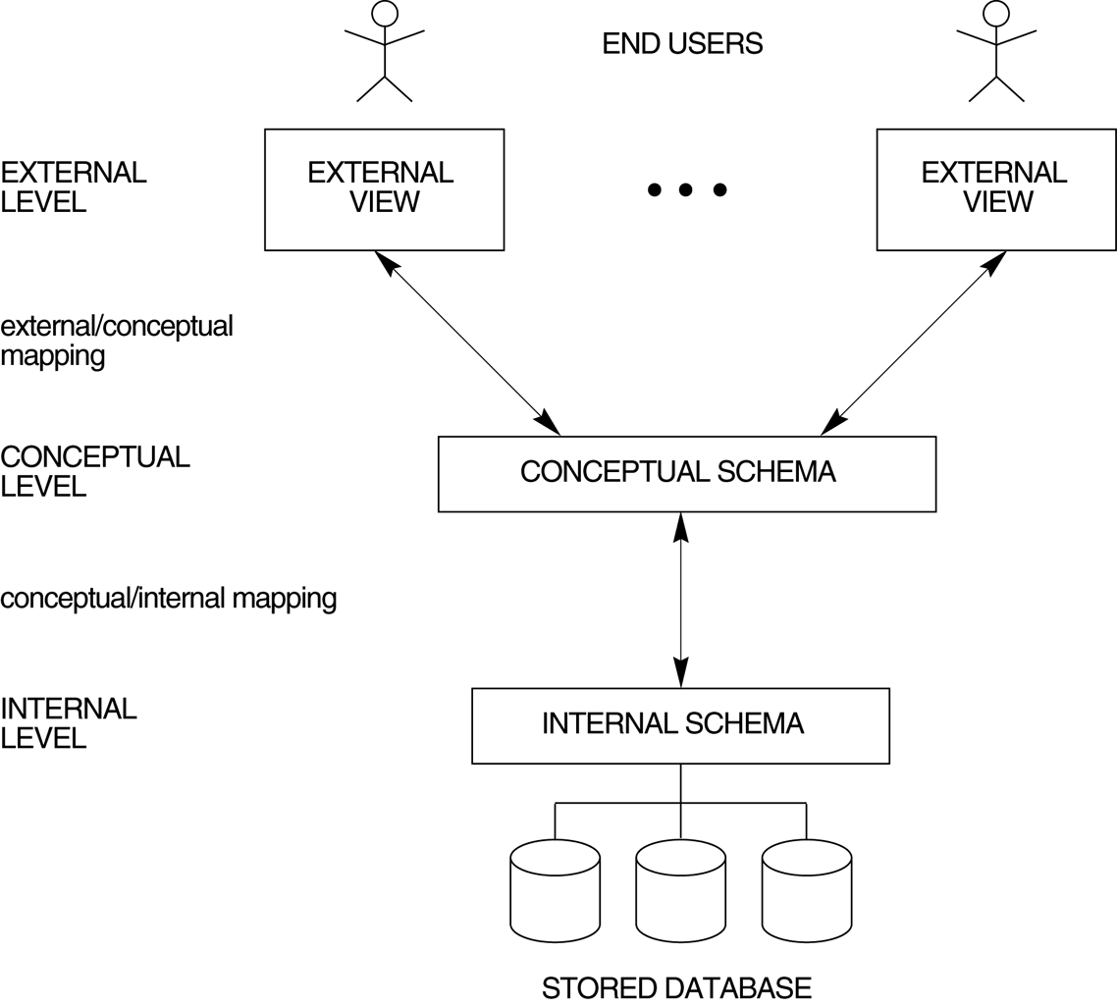
FIGURE 2.2
The three-schema architecture.

Slide 5
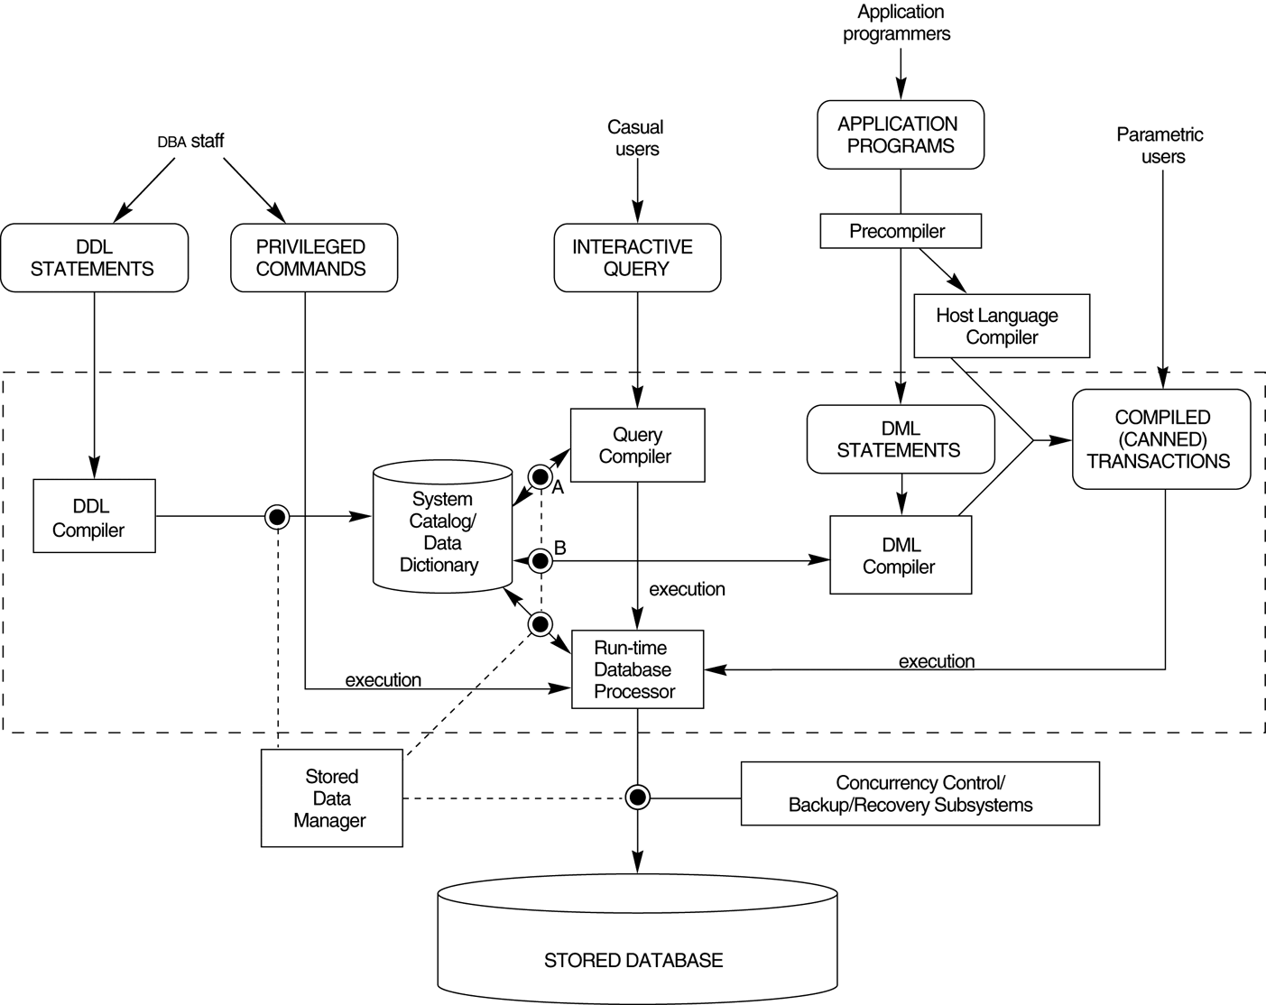
FIGURE 2.3
Component modules of a DBMS and their interactions.

Slide 6
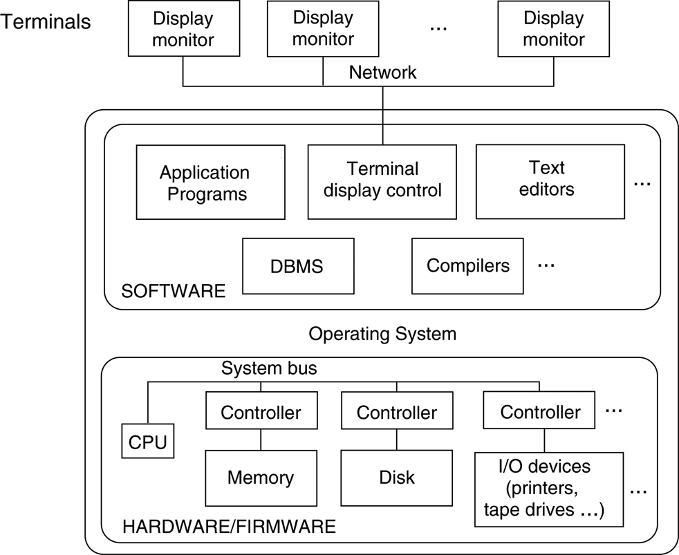
FIGURE 2.4
A physical centralized architecture.

Slide 7
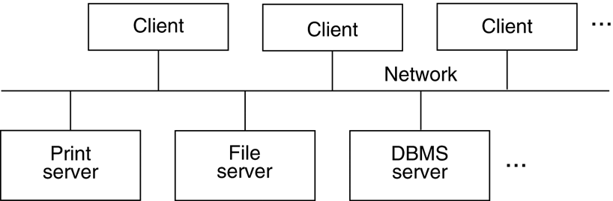
FIGURE 2.5
Logical two-tier client/server architecture.

Slide 8
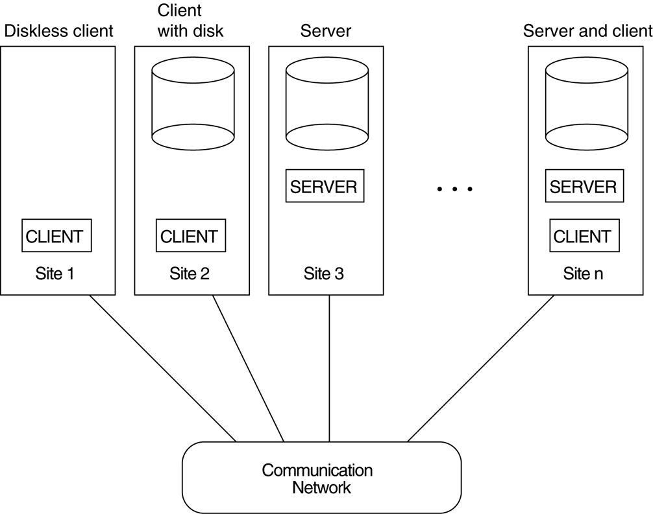
FIGURE 2.6
Physical two-tier client-server architecture.

Slide 9
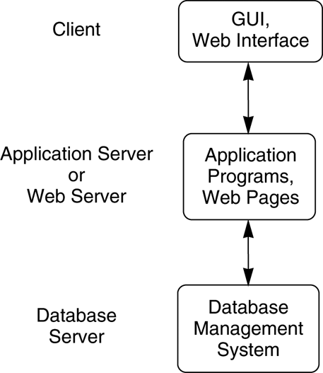
FIGURE 2.7
Logical three-tier client/server architecture.

Slide 10
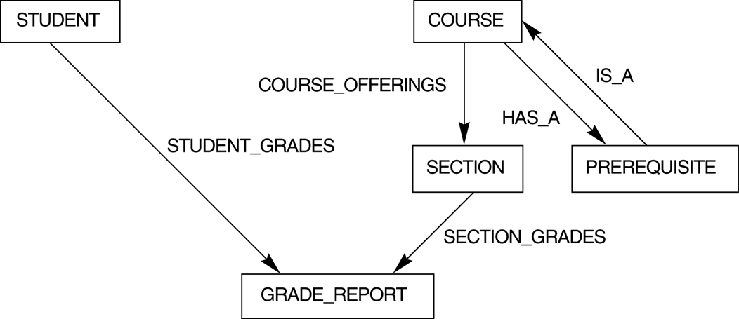
FIGURE 2.8
The schema of Figure 2.1 in network model notation.

